Slide 1
Counting Sort
By:
Lucas Hasting
Ethan Nix
Krutivas Pradhan

Slide 2
Necessary Definitions
Omega - Represents the lower bound of tbe running time of an algorithm.
Theta - Encloses the function from above and below. Since it represents the upper and the lower bound of the running time of an algorithm, it is used for analyzing the average-case complexity of an algorithm.
Big O - Represents the upper bound of the running time of an algorithm.
Cumulative - Gets the sum of x and all numbers before x
Array - A list of a single type of data
A list of only integers = an array of integers
Notes:
Ethan

Slide 3
Necessary Definitions
Count Sort - A sorting technique based on keys between a specific range. It works by counting the number of objects having distinct key values (a kind of hashing). Then do some arithmetic operations to calculate the position of each object in the output sequence.
R - A statistical Programming Language
R Studio - An Integrated Developer Environment (IDE) for the R language
For loop - A counter controlled loop
Iteration - What happens each time a loop is ran
Template - can be any type of data
In this presentation it is used as an integer
Notes:
Ethan

Slide 4
How the Counting Sort Works
What is it
A sorting algorithm that sorts an array by counting
How is it done?
Creates a count array of size max+1 and set each element to 0
Counts each number and increments the according element to the new array
Calculates the cumulative count of the array in order to place each number correctly in the array
Put the values in a temp array (using the original array)
Copy the array values over from the temp array to the original array
Notes:
Ethan

Slide 5
Counting Sort Example
Array = {1, 2, 3, 4, 5, 4, 4, 5, 2, 1}
count_Array = {0, 0, 0, 0, 0, 0}
count_Array = {0, 2, 2, 1, 3, 2}
count_Array = {0, 2, 4, 5, 8, 10}
temp_Array = {1, 1, 2, 2, 3, 4, 4, 4, 5, 5}
Array = {1, 1, 2, 2, 3, 4, 4, 4, 5, 5}
Notes:
Ethan
Creates a count array of size max+1 and set each element to 0
Counts each number and increments the according element to the new array
Calculates the cumulative count of the array in order to place each number correctly in the array
Put the values in a temp array (using the original array)
Copy the array values over from the temp array to the original array

Slide 6
Counting Sort Code
template <class T>
void countSort(T *array, int size) {
T *output = new T[size];
T max = getMax<T>(array, size);
T *count = new T[max+1]; //create count array (max+1 number of elements)
// Initialize count array with all zeros.
for (int i = 0; i <= max; ++i) {
count[i] = 0;
}
Notes:
Krutivas

Slide 7
Counting Sort Code
// Store the count of each element
for (int i = 0; i < size; i++) {
count[array[i]]++;
}
// Store the cumulative count of each array
for (int i = 1; i <= max; i++) {
count[i] += count[i - 1];
}
Notes:
Krutivas

Slide 8
Counting Sort Code
// Find the index of each element of the original array in count array,
// and place the elements in output array
for (int i = size - 1; i >= 0; i--) {
int element = array[i] - 1
output[count[element] = array[i];
count[array[i]]--;
}
Notes:
Krutivas

Slide 9
Counting Sort Code
// Copy the sorted elements into original array
for (int i = 0; i < size; i++) {
array[i] = output[i];
}
//delete the arrays
delete [] output;
delete [] count;
}
Notes:
Krutivas

Slide 10
Testing Process: Gathering Data
template <class T>
void Random(T *array, int size, int max){
srand(time(0));
for(int i = 0; i < size; i++){
T random = rand() % max;
array[i] = random;
}
}
template <class T>
void SemiRandom(T *array, int size){
Ascending(array, size);
for(int i = 0; i < size/2; i++){
T temp = array[i];
array[i] = array[size/2 + i];
array[size/2 + i] = temp;
}
}
//Functions Ascending() and Descending() are used to gather data as well
Notes:
Lucas

Slide 11
Testing Process: Timing Data
double test(T *array, int size, int max, string type = "Random")
{
clock_t t1, t2;
/* decide what to fill in the array based on type */
t1 = clock();
//test algorithm
countSort<T>(array, size);
t2 = clock();
float diff (float(t2) - float(t1));
return diff / CLOCKS_PER_SEC;
}
Notes:
Lucas

Slide 12
Testing Process: Recording Data
void dataWrite(string test_type, int size, int max, double time)
{
ofstream outfile;
outfile.open("data.csv", ios::app);
outfile << test_type << "," << max << "," << size << "," << time;
outfile << endl;
outfile.close();
}
//data.csv file example: Random,1000,1000,2.5
//example on how the function was called:
//dataWrite("Ascending", temp_size, temp_size, test<int>(arr, temp_size, 0, "Ascending"));
Notes:
Lucas

Slide 13
Testing Process: Data Used
We started with 150000000 (150 Million) numbers and tested 100 sets of data.
A for loop was used and it decreased the size by 1500000 (1.5 Million) each iteration
Notes:
Lucas

Slide 14
Testing Process: Analyzing Data
The data.csv was opened in R Studio. The following functions used to graph the data are listed below (they are examples):
subset(data, test_type == "test type")
plot(data, xlab = "x-label", ylab = "y-label", main = "Title", col = "color", pch = 19)
plot(1, type = "n", xlim=c(0,max),ylim=c(0,max), xlab = "x-label", ylab = "y-label", main = "Title")
points(data, col = "color", pch = 19
legend(XVAL, YVAL, legend=c(“Legend List"), col=c(“Color List”), pch = 19, cex=0.8)
The subset function was used to separate the data
the first plot function was used to graph the data individually
The second plot function allowed all graphs to show on one plot using the points function and displayed the legend with the legend function
Notes:
Lucas

Slide 15
Results: Best Case/Average Case/Worst Case
Assume A is an array of positive integers
Let N be the length of A and K be the maximum number in A
Best Case: Ω(N)
Average Case: Θ(N + K)
Worst Case: O(K)
Notes:
Lucas

Slide 16
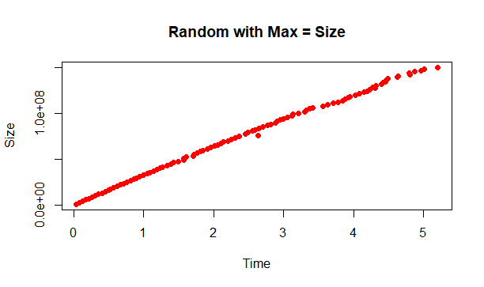
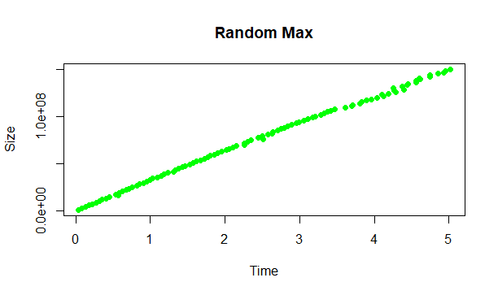
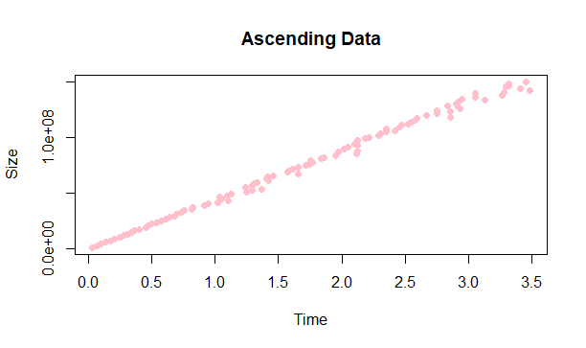
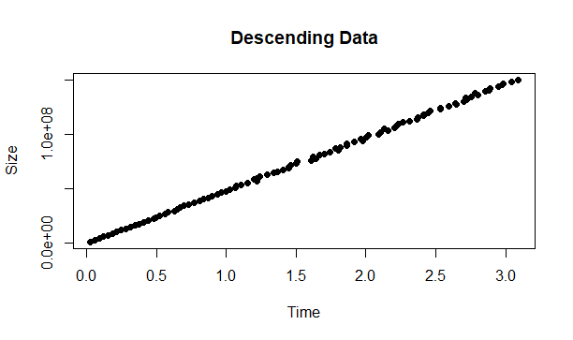
Notes:
Krutivas

Slide 17
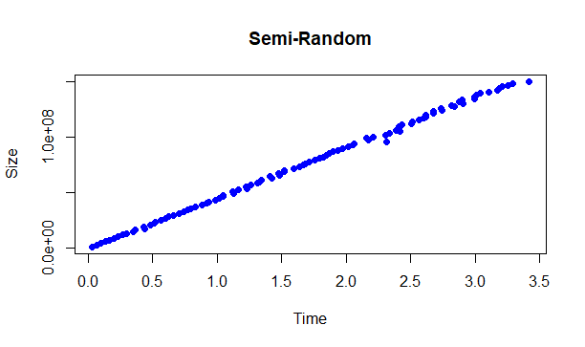
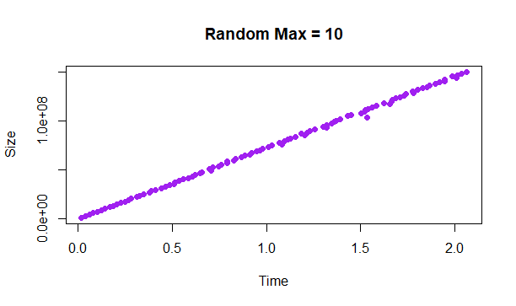
Notes:
Krutivas

Slide 18
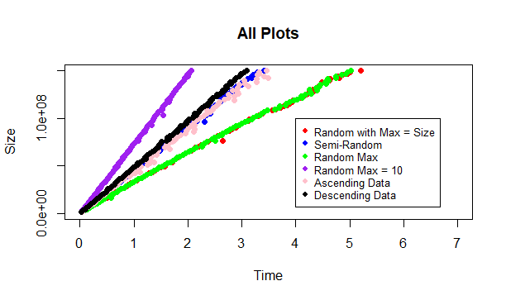
Notes:
Krutivas

Slide 19
Conclusions
When does your algorithm perform well?
The algorithm performs best when the maximum number is less than the size of the array
When is it not efficient?
It gets less efficient the higher the max number is when it exceeds the size of the array
When, if ever, should it be used?
The counting sort should only be used when there is an array of positive integers
Notes:
Ethan

Slide 20
References
.clock() and other assorted time functions: class code by Dr. Terwilliger
https://iq.opengenus.org/time-and-space-complexity-of-counting-sort/
https://www.tutorialspoint.com/cplusplus-program-to-implement-counting-sort
https://www.programiz.com/dsa/counting-sort
https://www.statmethods.net/management/subset.html
https://www.geeksforgeeks.org/how-to-overlay-plots-in-r/
http://www.sthda.com/english/wiki/add-legends-to-plots-in-r-software-the-easiest-way

Slide 21


